Slide 1
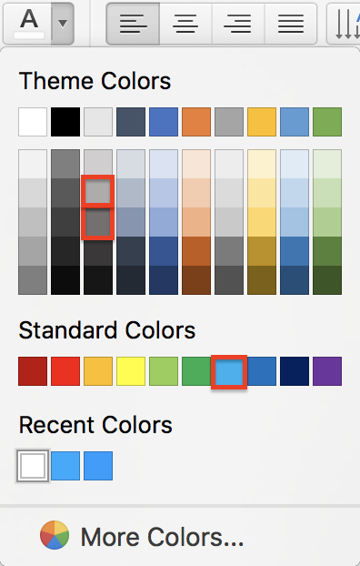
Instructions—Please read
The arrangement in this Instructions slide is not part of the style template and should be not replicated.
The typeface used in the template is Arial. Do not use any other font. The minimum type size for content is Arial Bold 20.
TRIUMF’s Theme colours for presentations are provided by default (top row of the image on the right). Do not change them. The highlighted blue in the image is TRIUMF’s Cyan Blue (the brand blue), used in this template for titles and highlights. All text in slides should be black or in one of the two highlighted grays. Do not use reds or purple.
Use one of the 5 provided options for cover/back-cover. Do not use these cover/back-cover formats anywhere else in your deck.
The images on the cover/back-cover formats are included in the collection of 30 TRIUMF stock images provided at the end. Feel free to use them or discard them at discretion.
Discard any unused slides. Those would make your presentation unnecessarily heavier.
Questions, comments and suggestions are welcome by TRIUMF’s Graphic Designer at diana@triumf.ca

Slide 2
PRESENTATION TITLE
Presenter’s Name
Division

Slide 3
PRESENTATION TITLE
Presenter’s Name
Division

Slide 4
PRESENTATION TITLE
Presenter’s Name
Division

Slide 5
PRESENTATION TITLE
Presenter’s Name
Division

Slide 6
PRESENTATION TITLE
Presenter’s Name
Division

Slide 16
Thank you Merci
www.triumf.ca
Follow us @TRIUMFLab

Slide 17
Thank you Merci
www.triumf.ca
Follow us @TRIUMFLab

Slide 18
Thank you Merci
www.triumf.ca
Follow us @TRIUMFLab

Slide 19
Thank you Merci
www.triumf.ca
Follow us @TRIUMFLab

Slide 20
Thank you Merci
www.triumf.ca
Follow us @TRIUMFLab

